Slide 1

Estructuras de Datos II
JONATHAN LÓPEZ LONDOÑO
JLOPEZL@UAO.EDU.CO
315 926 5443

Slide 2

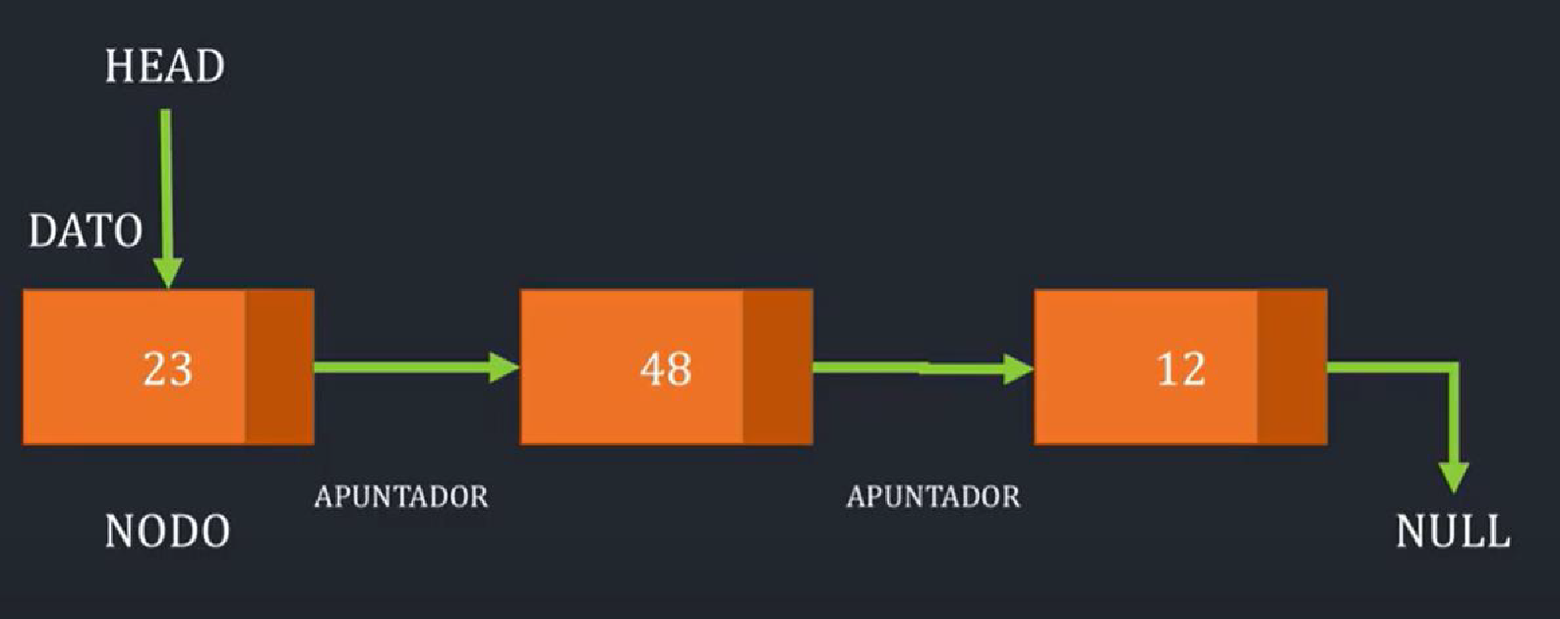
Linked Lists
They are like Arrays in JavaScript, but not the same.
They are a structure of linked elements.

Slide 3
Linked Lists
✓ Node: Every element in the list. Each node will have 2 parts:
  Value (node ​​data).
  Reference (pointer) to the next node in the list.
  ✓ Head: Is the first node in the list.
✓ Pointer: Link to next object.
✓ Tail: Last node in the list, this node will point to null.

Slide 4
Linked Lists Methods
A list must have methods that allow adding new elements, removing them and reviewing them (one or more).
We can make our own implementation and call these methods in any way.
There is an agreed convention of using the following definitions:
append: Adds a new node to the list, placing it at any place you like, even at bottom of the list.
peek: Returns some node entered on the list.
size: Returns the number of elements in the list.
remove: Removes a node from the list and joins previous and next node from this removed.
print: Prints the contents of the stack.

Slide 5
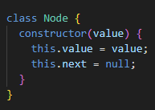
How to implement Linked Lists?
First, you need to use a Node Class, with a value and a next in the constructor.

Slide 6
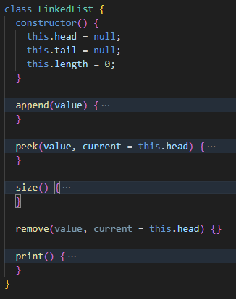
How to implement Linked Lists?
Second, you need to use a LinkedList class with a head, a tail and a length in the constructor method.

Slide 7
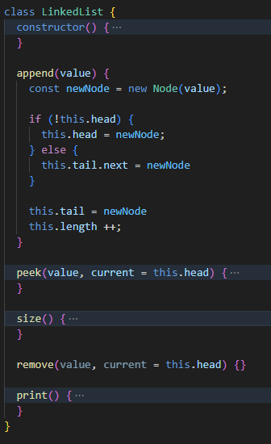
How to implement Linked Lists?
Third, you need to implement basic methods:
append: Adds a new node to the list, placing it at any place you like, even at bottom of the list.

Slide 8
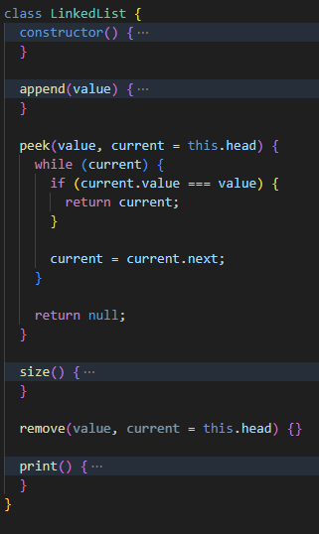
How to implement Linked Lists?
Third, you need to implement basic methods:
✓ peek: Returns some node entered on the list.

Slide 9
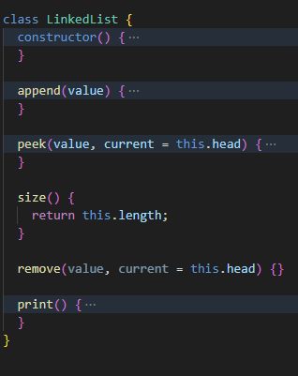
How to implement Linked Lists?
Third, you need to implement basic methods:
✓ size: Returns the number of elements in the list.

Slide 10
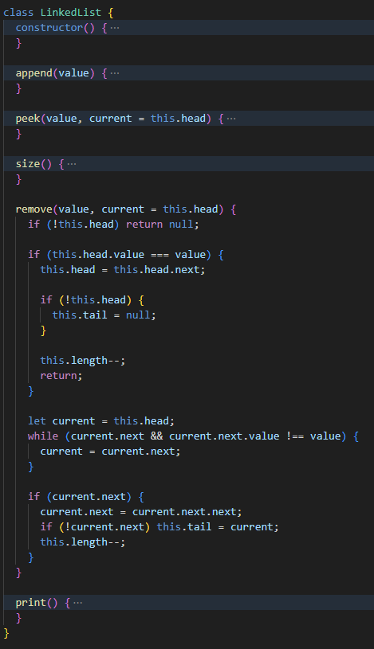
How to implement Linked Lists?
Third, you need to implement basic methods:
✓ remove: Removes a node from the list and joins previous and next node from this removed.

Slide 11
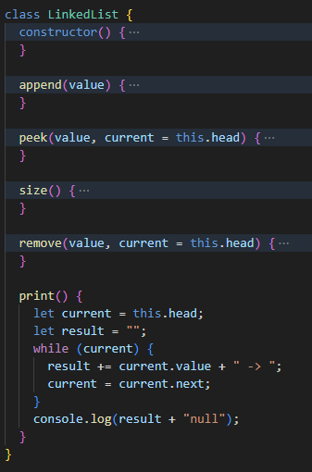
How to implement Linked Lists?
Third, you need to implement basic methods:
✓ print: Prints the contents of the stack.

Slide 12

Double Linked Lists
They are a structure of linked elements by its previous and its next node.
They are used to go through the list from head to tail and vice versa.

Slide 13
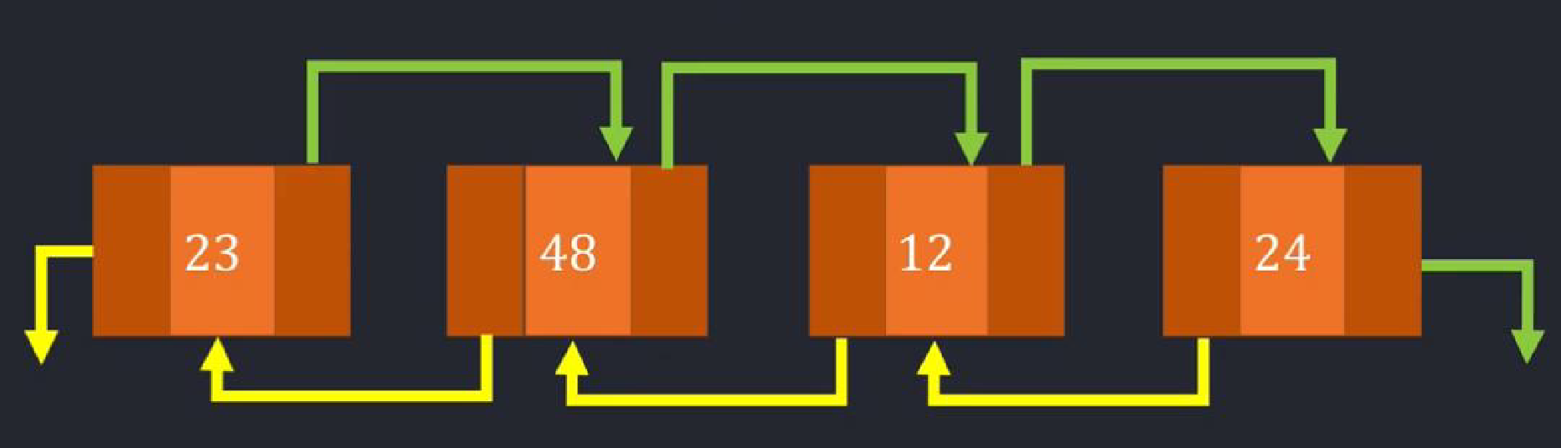
Linked Lists
✓ Node: Every element in the list. Each node will have 2 parts:
  Value (node ​​data).
  Reference (pointer) to the next node in the list.
  ✓ Head: Is the first node in the list.
✓ Pointer: Link to next/previous object..
✓ Tail: Last node in the list, this node will point to null.

Slide 14
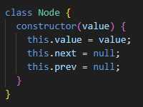
How to implement Linked Lists?
First, just add a previous constructor of Node Class.

Slide 15
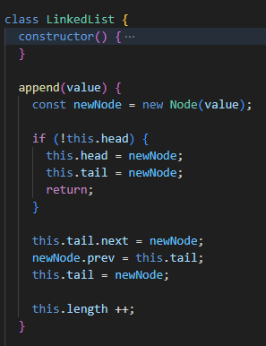
How to implement Linked Lists?
Second, add a previous in the append method of LinkedList Class.

Slide 16
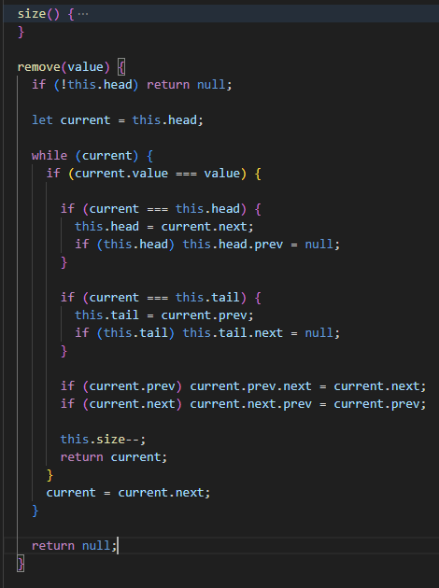
How to implement Linked Lists?
Third, add a previous in the remove method of LinkedList Class.

Slide 17
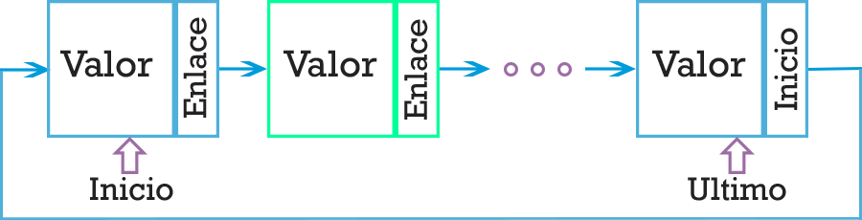
Circular Linked Lists
They are a structure of linked elements from their last node to their first node.
They are used to go through the list from tail to head.

Slide 18

CHALLENGE 03
Implement a linked list to play songs in order. Fill the list with mocked data
Implement a doubly linked list to navigate back and forward between visited pages in the browser . Fill the list with fake data
Create a project in react with 2 new pages, linked and doubly linked lists.
Use the implemented lists in each page. Navigate through the lists by using buttons inside the pages

